Slide 1
Streams
Introducing streams
Amigo
Working with streams
Have a full understanding of what streams are.
How you can use them concisely and efficiently.
Collecting data with streams
Parallel data processing and performance
https://coggle.it/diagram/XUzq6HMyQ4LEEuSz/t/stream-internal-iteration/3c809a1e0819b466a59e2df4983cb0917819211c3fcad0e571878661e90f8852

Slide 2
Introducing Streams
What is a stream?
Collections versus streams
Internal versus external iteration
Streams operations

Slide 3
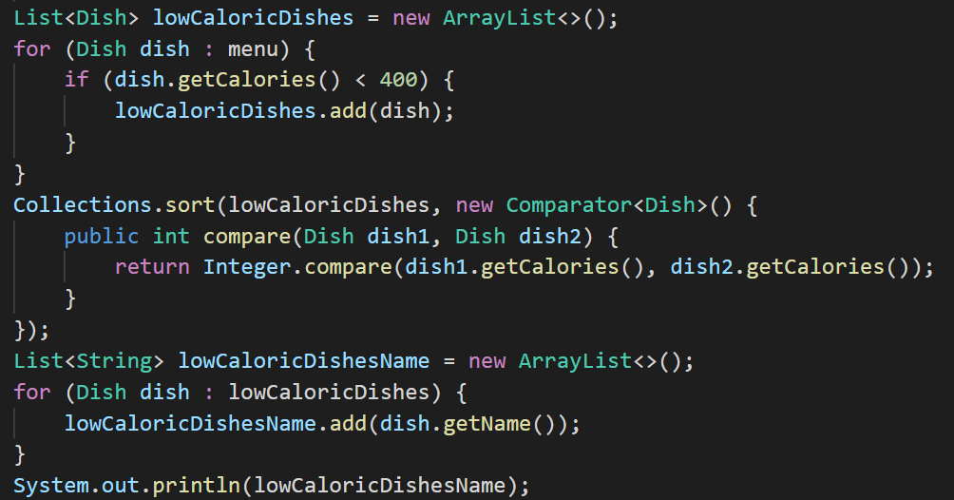
What is Streams?
Streams are an update to the Java API that let you manipulate collections of data in a declarative way.
Can be processed in parallel transparently, without you having to write any multithreaded code.

Slide 4
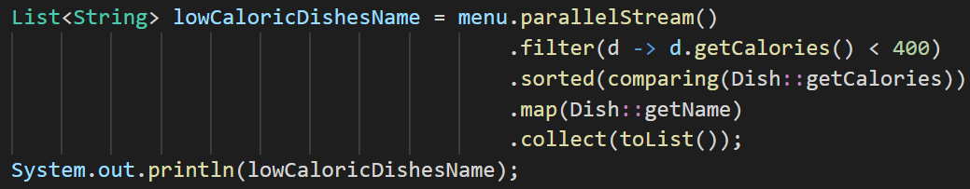
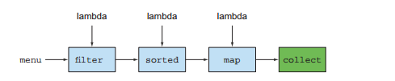
What is Streams?

Slide 5
Advantages:
Declarative - More concise and readable
Composable - Greater flexibility
Parallelizable - Better performance

Slide 6

“A sequence of elements from a source that supports data-processing operations.”
Pipelining
Internal Iteration
Notes:
Pipelining—Many stream operations return a stream themselves, allowing operations to be chained to form a larger pipeline. This enables certain optimizations that we explain in the next chapter, such as laziness and short-circuiting. A pipeline of operations can be viewed as a database-like query on the data source.
Internal iteration—In contrast to collections, which are iterated explicitly using
an iterator, stream operations do the iteration behind the scenes for you. We briefly mentioned this idea in chapter 1 and will return to it later in the next section.

Slide 7
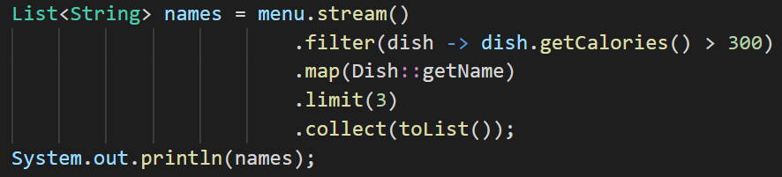
Output: [pork, beef, chicken]
Notes:
Pipelining—Many stream operations return a stream themselves, allowing operations to be chained to form a larger pipeline. This enables certain optimizations that we explain in the next chapter, such as laziness and short-circuiting. A pipeline of operations can be viewed as a database-like query on the data source.
Internal iteration—In contrast to collections, which are iterated explicitly using
an iterator, stream operations do the iteration behind the scenes for you. We briefly mentioned this idea in chapter 1 and will return to it later in the next section.

Slide 8
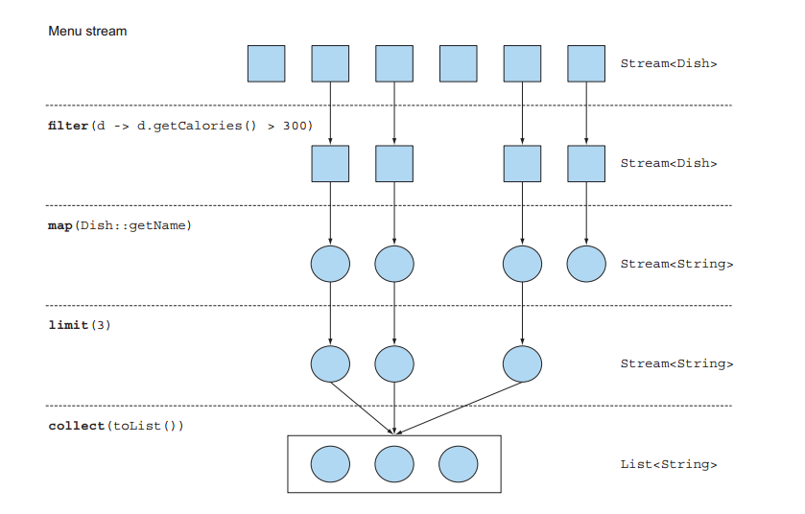

Slide 9
Stream and Collection

Slide 10
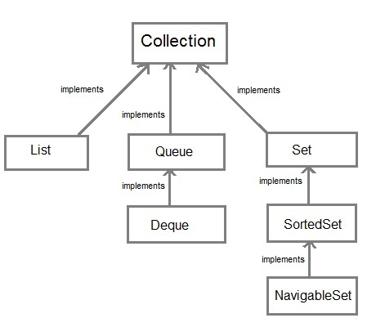
Comparation
Stream
Computed on demand
Lazily constructed
Collection
Computed before becoming
Eagerly constructed

Slide 11
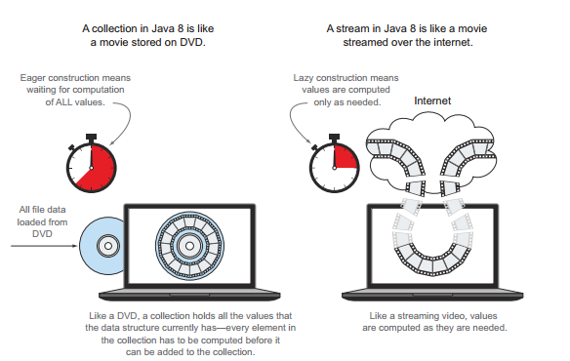
Comparation

Slide 12
Comparation
Internal
Could 2 or more as the same time and can decide to take the objects first
External
Explicitly pulling out & processing the items one by one

Slide 13
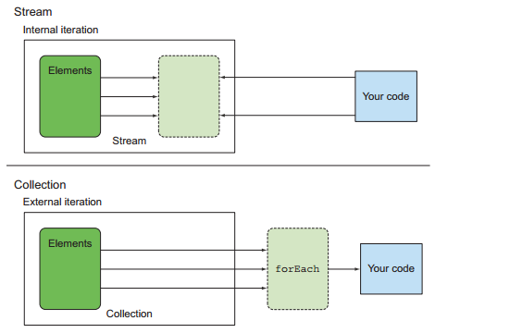
Comparison

Slide 14
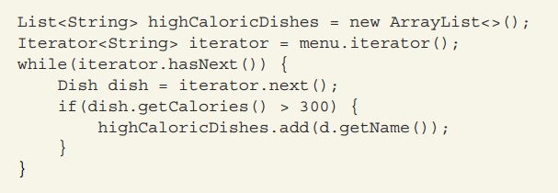
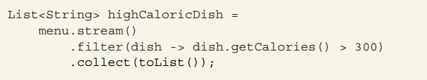
Example
Collection- External iteration
Stream - Internal iteration

Slide 15
Stream operations

Slide 16
Intermediate operations
Can be connected together to form a pipeline
Return another stream
Don’t perform any processing until a terminal operation is invoked on the stream pipeline

Slide 17
Intermediate operations
Stateless
Stateful
Each element is processed independently of the others
The processing of an element may depend on aspectects of thee other element
Don’t store any state
Store state to calculate a value
Easy to handle
Not easy to handle, specially parallel

Slide 18
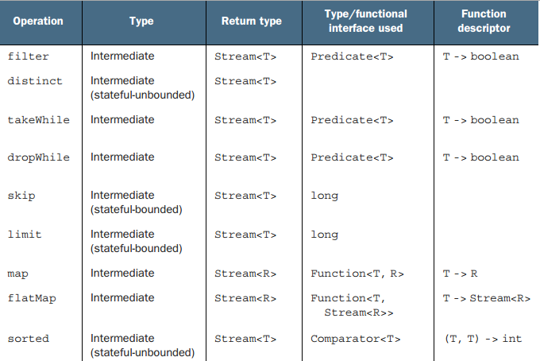
Intermediate operations

Slide 19
Terminal operations
Executes the stream pipeline and produces a result
Return a non-stream value
After its execution, the stream can not be revisted

Slide 20
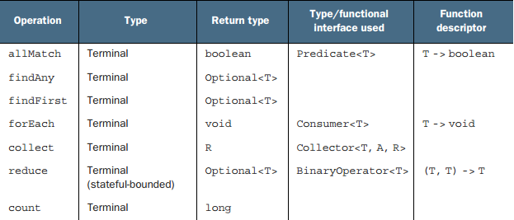
Terminal operations

Slide 21
Working with Stream
Filtering
Slicing a stream
Mapping
Reducing
Numberic streams

Slide 22
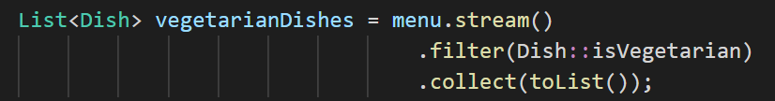
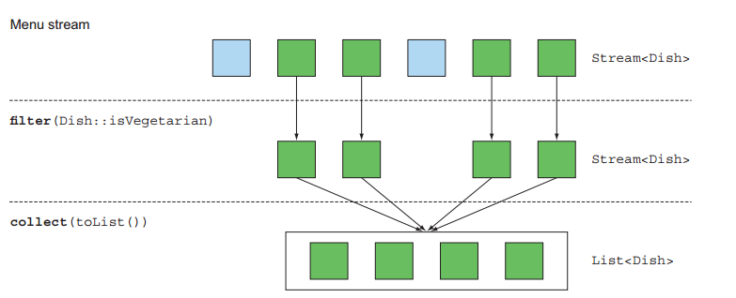
Filtering with a predicate
Output: [seasonal fruit, french fries, rice, pizza]

Slide 23
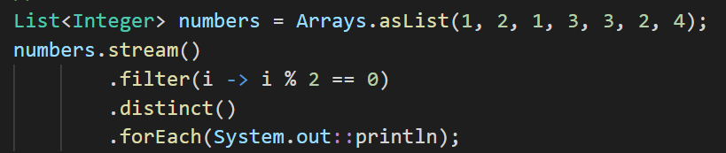
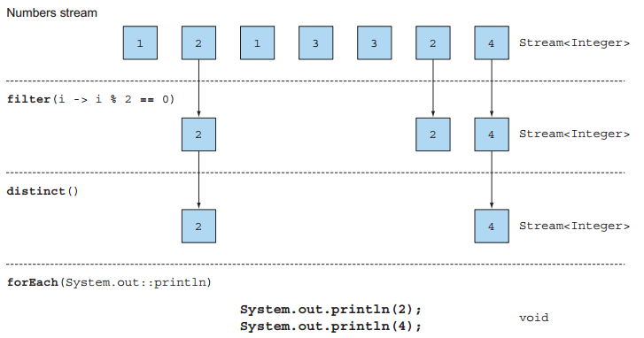
Filtering unique elements
Output: 2 4

Slide 24
Slicing using a predicate
takeWhile (J9): slice any stream using a predicate. It stops once it has found an element that fails to match
dropWhile (J9): is the complement of takeWhile. It throws away the elements at the start where the predicate is false

Slide 25
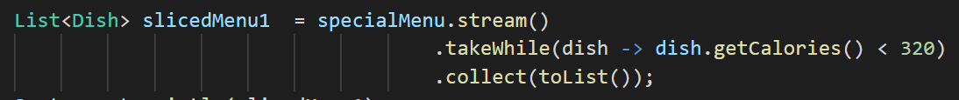
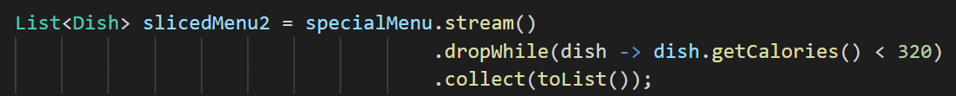
Example
Given list: [seasonal fruit, prawns, rice, chicken, salmon, french fries, pizza, beef, pork]
takeWhile
Output: [seasonal fruit, prawns]
dropWhile
Output: [rice, chicken, salmon, french fries, pizza, beef, pork]

Slide 26
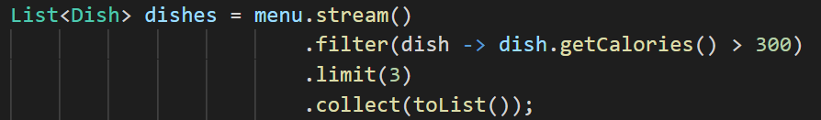
Truncating a stream
Streams support the limit(n) method, which returns another stream that’s no longer than a given size.
Limit and filter can combine parallel
Output: [pork, beef, chicken]

Slide 27
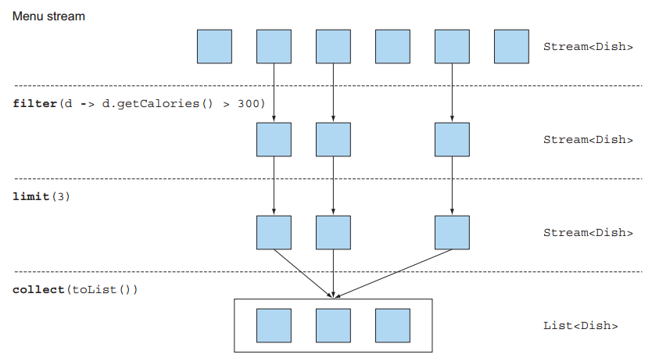
Truncating a stream

Slide 28
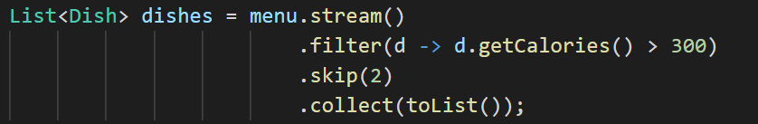
Skipping elements
The skip(n) method to return a stream that discards the first n elements.
Filtered list without skipping: [pork, beef, chicken, french fries, rice, pizza, salmon]
Output: [chicken, french fries, rice, pizza, salmon]

Slide 29
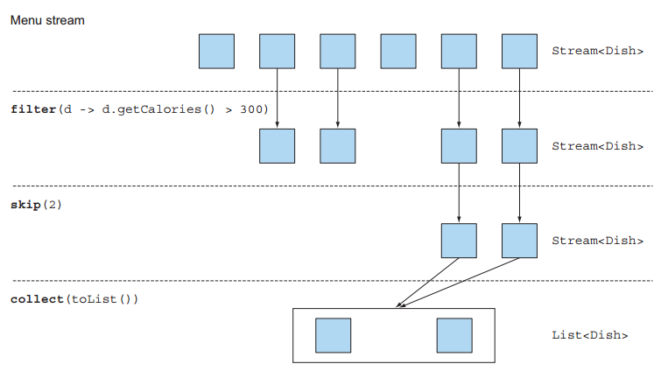
Skipping elements

Slide 30
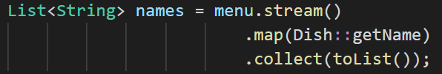
Mapping apply a function to each element of a stream
The map method takes a function as argument. The function is applied to each element, mapping it into a new element
Output: [seasonal fruit, pork, beef, chicken, french fries, rice, pizza, prawns, salmon]

Slide 31
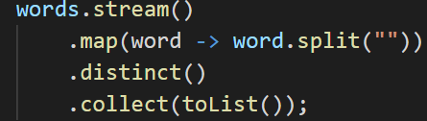
Example
How could you return a list of all the unique characters for
a list of words?
For example, given the list of words ["Hello," "World"] you’d like to return the list ["H," "e," "l," "o," "W," "r," "d"]

Slide 32
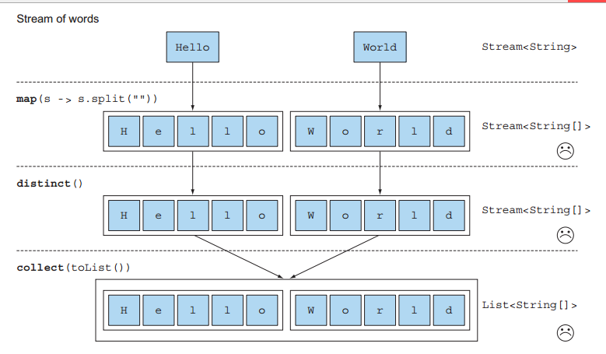
Example

Slide 33
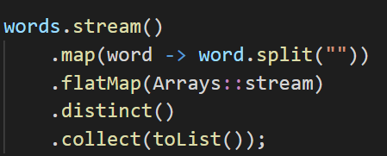
Mapping use flatMap
The flatMap method has the effect of mapping each array not with a stream but with the contents of that stream.
All the separate streams that were generated when using
map(Arrays::stream) get amalgamated—flattened into a single stream.

Slide 34
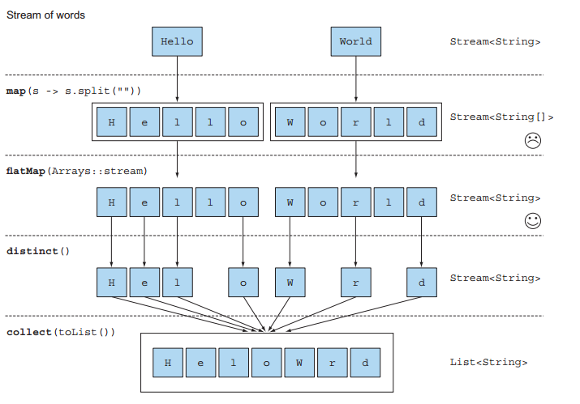
Mapping use flatMap

Slide 35
Finding and matching
Method | Description | Return
anyMatch() | check an existing element of the stream match the given predicate | boolean
allMatch() | check no elements in the stream match the given predicate | boolean
noneMatch() | check no elements in the stream match the given predicate | boolean
findAny() | find the any element | an arbitrary element of the current stream
findFirst() | find the first element | the first element of the current stream

Slide 36
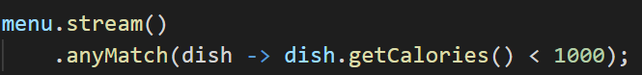
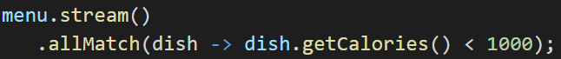
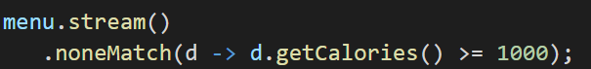
Example
Notes:
Finding the first element is more constraining in parallel. If you don’t care about which element is returned, use findAny because it’s less constraining when using parallel streams.

Slide 37
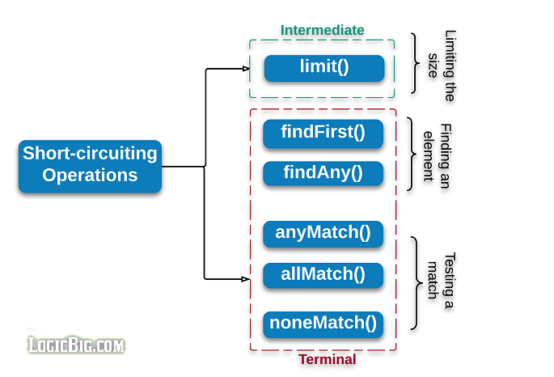
Short-circuiting evaluation
Don’t need to process the whole stream to produce a result
Notes:
A short circuit operator is one that doesn't necessarily evaluate all of its operands

Slide 38
Reducing
That method allows to produce one single result from a sequence of elements
The benefit of using reduce is that the iteration is abstracted using internal iteration, which enables the internal implementation to choose to perform the reduce operation in parallel.

Slide 39
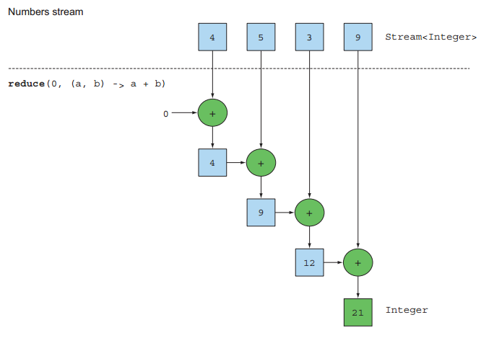
Summing the elements
Notes:
From Java 8 the Integer class now comes with a static sum method to add two numbers
You don’t need the initial value, but use optional for result to check null exception

Slide 40
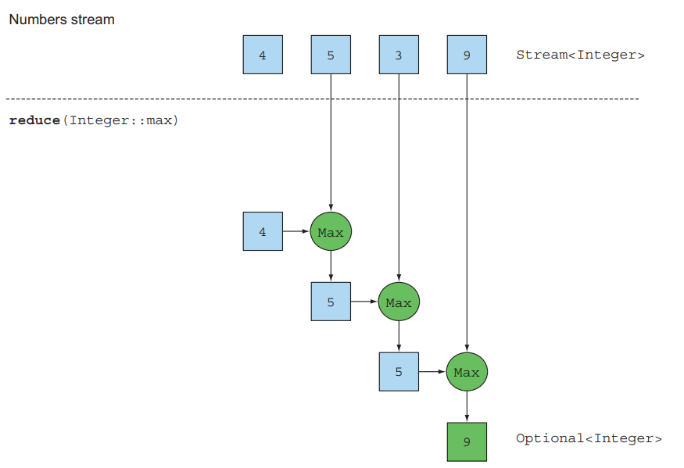
Maximum and minimum
Notes:
You don’t need the initial value, but use optional for result to check null exception

Slide 41
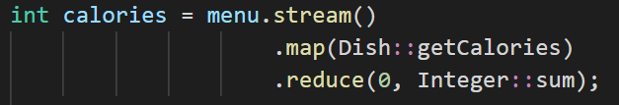
Numeric streams
Boxing cost to be unboxed to a primitive type
Notes:
A short circuit operator is one that doesn't necessarily evaluate all of its operands

Slide 42
Primitive stream specializations
IntStream, DoubleStream, and LongStream
Respectively specialize the elements of a stream to be int, long, and double
Avoid hidden boxing costs
Use mapToInt, mapToDouble, mapToLong to convert a stream to a specialized version
Notes:
A short circuit operator is one that doesn't necessarily evaluate all of its operands

Slide 43
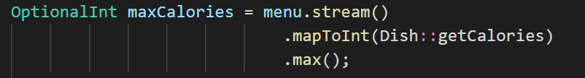
Primitive stream specializations
Notes:
A short circuit operator is one that doesn't necessarily evaluate all of its operands

Slide 44
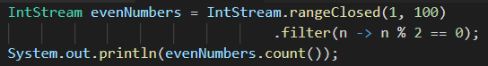
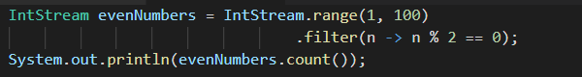
Numeric ranges
We can use range() instead, the result would be 49 even numbers because range is exclusive
Output: [2,4,6,...100]
Output: [2,4,6,...98]
Notes:
A short circuit operator is one that doesn't necessarily evaluate all of its operands

Slide 45
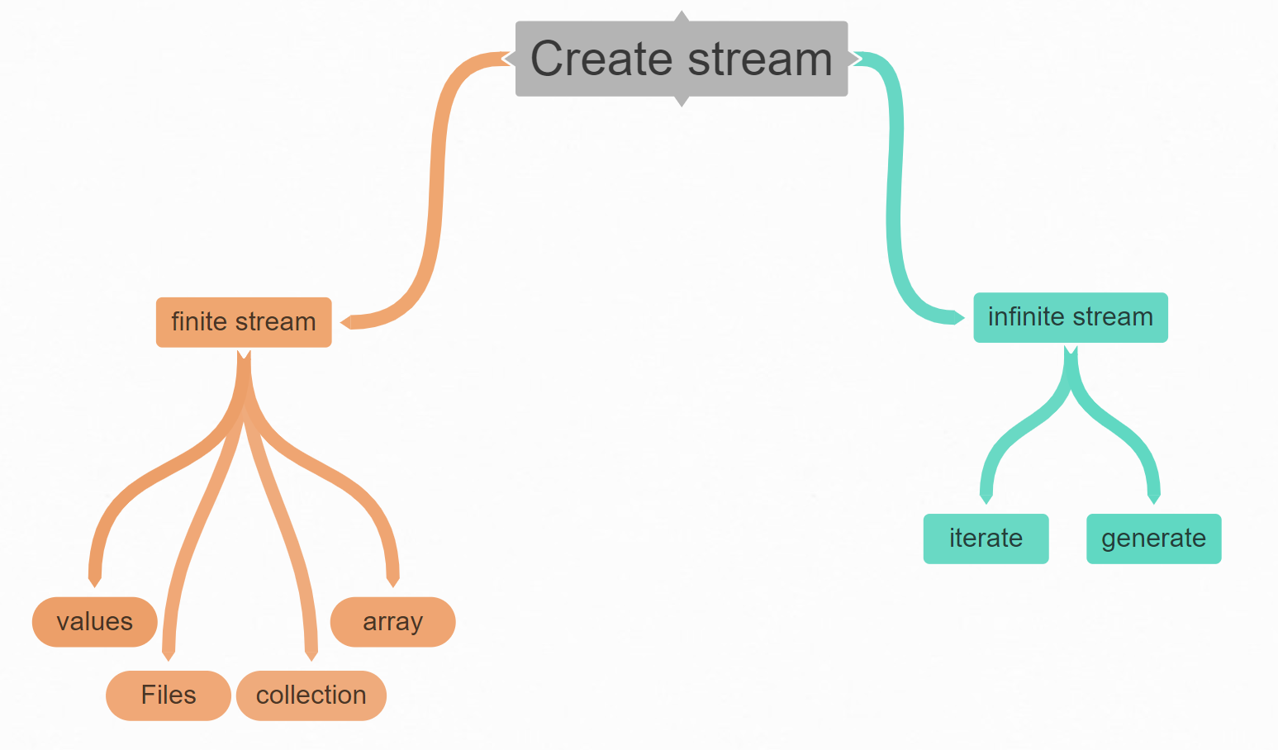
Building stream
Notes:
A short circuit operator is one that doesn't necessarily evaluate all of its operands

Slide 46
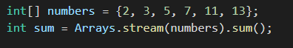
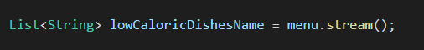
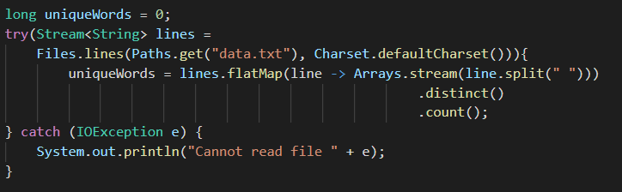
Finite stream
by value
by array
by collection
by file
Notes:
A short circuit operator is one that doesn't necessarily evaluate all of its operands

Slide 47
Infinite stream
Iterate: takes an initial value and a lambda to apply successively on each new value produced
Generate: takes a lamda of type supplier to provide new values
Notes:
A short circuit operator is one that doesn't necessarily evaluate all of its operands

Slide 48
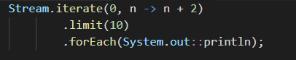
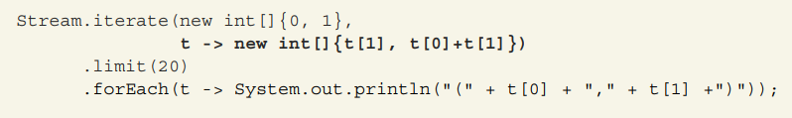
Iterate
Practice: You have a sequence of a number and its successor in the series: (0, 1), (1, 1), (1, 2), (2, 3), (3, 5), (5, 8), (8, 13), (13, 21). . . . Your task is to generate the first 20 elements of the series of Fibonacci tuples using the iterate method
Notes:
A short circuit operator is one that doesn't necessarily evaluate all of its operands

Slide 49
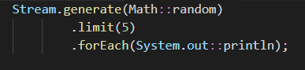
Generate
Note:
You’re dealing with a stream of infinite size, you have to limit its size explicitly using the operation limit; otherwise, the terminal operation will compute forever.
Can’t sort or reduce an infinite stream because all elements need to be processed
Notes:
A short circuit operator is one that doesn't necessarily evaluate all of its operands

Slide 50
Collecting data with stream
Overall
Reducing and summarizing
Grouping
Partitioning
The collection interface

